Slide 1
The absorption and elimination of alcohol
What is alcohol
How is it absorbed
How is it eliminated
What is a unit of alcohol
How can a unit be calculated
A unit the drink drive law and you

Slide 2
What is alcohol
Alcohol is Ethanol
Naturally occurs in fermentation
Added artificially ( Alco-pops)
It is a drug
It is a poison

Slide 3
How is alcohol absorbed
Swallowed
Goes through stomach & intestine wall
Into blood and pumped by heart
To the brain
All within 5 minutes

Slide 4
How eliminated
Breath
Sweat
Urine
Liver
2% - 4%
2% - 6%
2% - 4%
90% approx.

Slide 5
What is ABV
Alcohol by volume
14% ABV
Means 14% of content is alcohol

Slide 6
What is a unit
For calculation purposes a unit of alcohol is the average amount of alcohol a healthy body can eliminate in 1 hour

Slide 7

What equals a unit
Half pint of 3.5% abv beer
125ml glass of 9% abv wine
25ml glass of 40% abv spirit

Slide 8
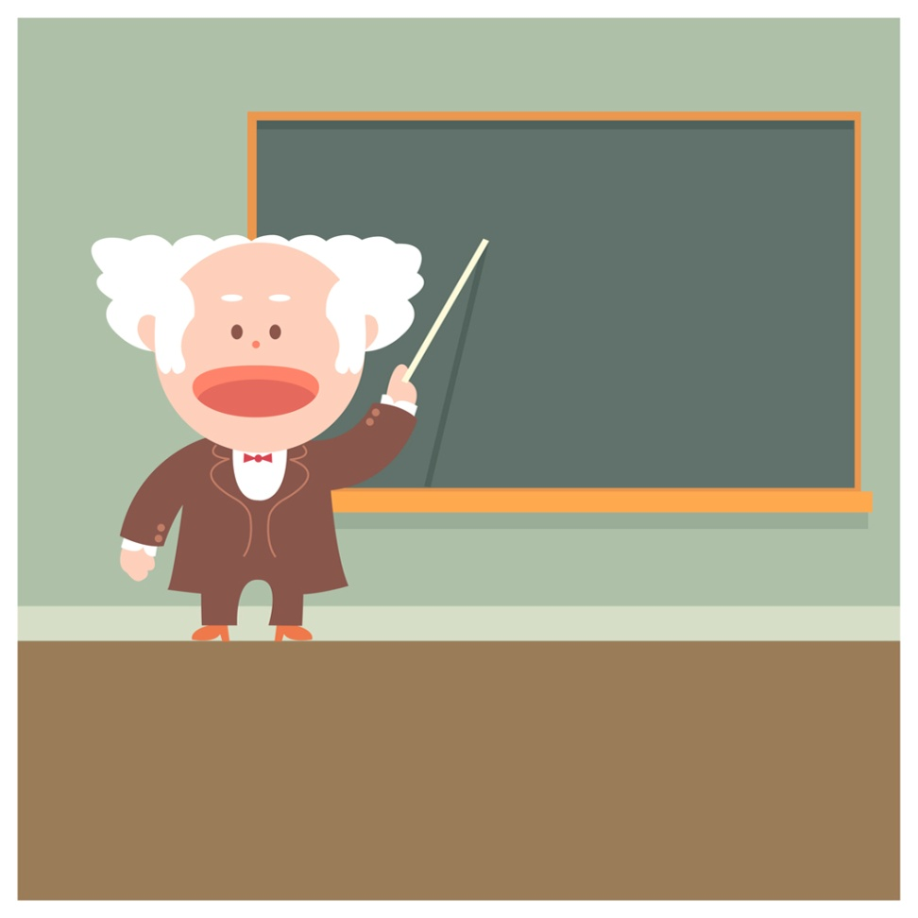
How to calculate units
Volume x ABV divided by 1000
Example 330ml bottle of 5% abv beer.
330x5 = 1650/1000
= 1.65 units.
For safety always round up = 2 units

Slide 9
The Law
Breath
Blood
Urine
35ug (microgrammes)
80mg (milligrams)
107mg (milligrams)

Slide 10
The Reality
Driving at the British legal limit can make a driver up to 5 times likelier to crash
Even small amounts of alcohol can double the risk of crashing
The legal limit is not necessarily the safe limit
Highest limit in Europe

Slide 11
The Effects
1 unit of alcohol = 7ug of breath (Maybe!) HOWEVER
Gender
Size
Fitness
Medication
Mood
Food
Topping up

Slide 12
The effect
If 7ug breath = unit
Large Adult Male
Small Adult Female
5 units = 35ug limit
5 units = 65/80 blood
5 units = 112/80 blood

Slide 13
The morning after
Friday night drinks from 9pm to Midnight
Drinks 5 pints of 4.2% abv Lager and 2 double Jack Daniels
In bed by 12.30

Slide 14
The morning after
When would you be happy for this pupil to drive your car?

Slide 15
The morning after
Lager = 12.5 units
Jack Daniels = 4 units
16.5 units = 16.5 hours approx. to leave body
Alcohol free 1.30pm next day

Slide 16
Warning
There are no hard and fast rules for calculating alcohol elimination
Drink driving offences stay on your licence for 11 years (10 years for re-offending)
Banned for at least 1 year first offence
On the CRB register and PNC number for 5 years (in most cases)

